Slide 1
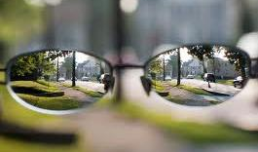

Irlen Syndrome:
What Everyone Needs To Know
www.irlen.com
Notes:
This presentation document is intended for an adult or professional audience. You may remove any slides that you do not feel are relevant for your audience. If you have questions about any of the information in this document, you may contact sandy@irlen.com for clarification or additional information. Thank you for helping to spread the word about Irlen Syndrome!

Slide 2
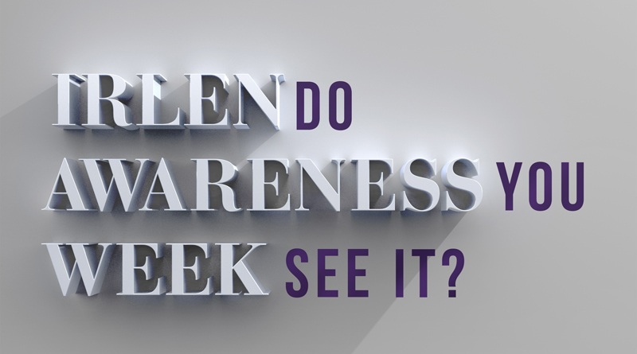
Join Us: Irlen Awareness Week 2014
While the disorder is more common than autism, heart disease, and asthma, it often goes undiagnosed, or gets misdiagnosed as other disorders such as dyslexia, behavioral or psychiatric problems, and ADHD. Failure to treat Irlen Syndrome leads to academic and workplace failure, ongoing physical and emotional symptoms, and increased likelihood to enter the criminal justice system. The syndrome is easy to identify and treat, and treatment through the use of non-invasive Spectral Filters worn as glasses leads to immediate and dramatic improvements.
Join Us To Raise Awareness:
Web: http://irlen.com/irlen-syndrome-awareness-week-2014/
Facebook: Irlen Awareness Week
Twitter: @seeirlen #irlenawareness

Slide 3
3 Key Takeaways
Identify the Problem
Be able to identify the signs and symptoms of Irlen Syndrome
Understand the Impact
Understand how the syndrome manifests itself in different populations and the mind-body-learning connection
Familiarity with the Solution
Learn about the Irlen Method and other modifications and accommodations you can use to help your students

Slide 4
What Is A Perceptual Processing Difficulty?
A hindered ability to make sense of information taken in through the eyes
Different from problems involving sight or sharpness of vision
Affect how visual information is interpreted, or processed by the brain

Slide 5
Irlen Discovery
Research based
US Federal research grant
Single study research design with 1,500 adults
Conducted between 1980-1983 by Helen Irlen
Helen Irlen presented at American Psychological Association Conference (APA) 1983

Slide 6
Main Facts
Over 10,000 educators trained
Over 100,000 wear Irlen Spectral Filters
Millions use Irlen colored overlays
Recognized as a standard low tech assistive technology for testing
Recognized by Recordings for the Blind, Voc Rehabs, Dept. of Rehabs, SAT, ACT, LSAT

Slide 7

Global Impact
171 Irlen Centers in 46 countries

Slide 8
THE PROBLEM
What is Irlen Syndrome?

Slide 9

A Visual-Perceptual Disorder
1. Visual cortex
2. Transient, or magnocellular deficit
  Problem With The Brain, Not The Eye

Slide 10

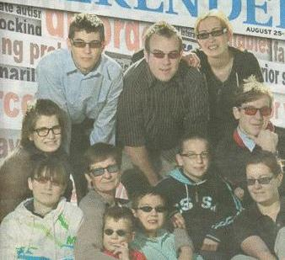
Hereditary
  Runs In Families
  Genetic predisposition,
  runs in families
  Affects males and
  females equally
  Can also be
  acquired via
  injury, illness,
  medical procedures
Family of 10 wearing Irlen Spectral Filters

Slide 11
A Spectrum Disorder
The Irlen Continuum
Slight
Moderate
Severe
Symptoms Begin:
40-60 minutes
Symptoms Begin:
20-40 minutes
Symptoms Begin:
0-20 minutes
  Falls On A Continuum

Slide 12

A Variety of Symptoms
Light Sensitivity
Inefficient Reading
Slow Reading Rate
Attention Deficit
Strain or Fatigue
Poor Depth Perception
Notes:
LIGHT SENSITIVITY
Discomfort or difficulty concentrating or working under bright lights or fluorescent lights. Also bothered by glare, sunlight, or driving at night.
INEFFICIENT READING
Skipping words or lines, loses place, misreading words, reading lines from above or below, repeating lines, weak comprehension, or rereading for comprehension.
SLOW READING RATE
Inability to read letters, numbers, musical notes, or words in groups. Problems tracking, correctly identifying words, or ability to skim/speed read.
ATTENTION DEFICIT
Problems concentrating while reading or doing school work. May have difficulty staying on task, take breaks, look away, become restless, fidgety, or tired.
STRAIN OR FATIGUE
Feeling strain, tension, fatigue, sleepy, watery eyes, eyes that hurt, ache, feel sandy, scratchy, getting headaches, or feeling nauseous, dizzy, anxious, fidgety, or irritable with reading and other perceptual activities.
POOR DEPTH PERCEPTION
Inability to accurately judge distance or spatial relationships. May be unsure or have difficulty with escalators, stairs, ball sports, or driving.

Slide 13
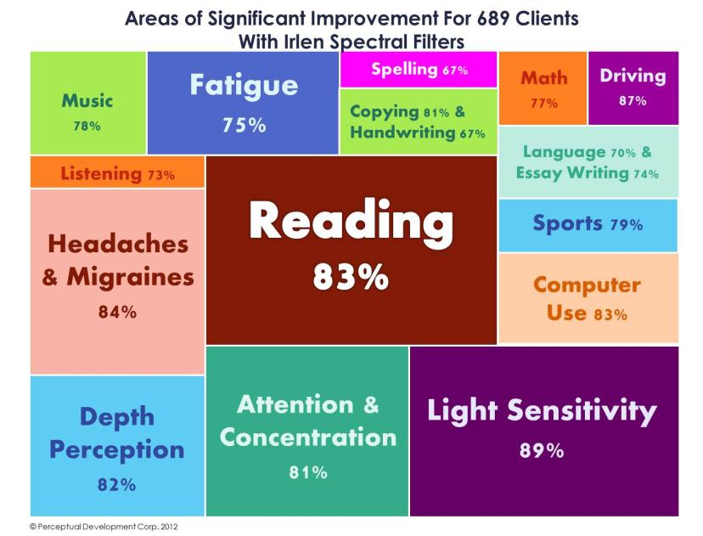
Areas Impacted
Notes:
Research conducted by the Irlen Institute has shown that Irlen Syndrome impacts more than 20 areas of functioning, from reading skills to driving. The graphic on this slide shows what percent of people with Irlen Syndrome who had difficulty in a particular area also showed significant improvement in that area with Irlen Spectral Filters.

Slide 14
Triggered by Environment
Notes:
Symptoms of Irlen Syndrome can be triggered by a variety of different environmental factors.

Slide 15
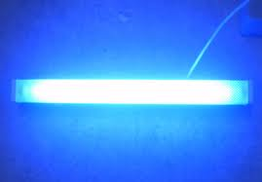
Lighting
Bright And Fluorescent Lighting

Slide 16


Glare

Slide 17

Bright Colors

Slide 18


High Contrast

Slide 19




Patterns and Stripes

Slide 20



Details

Slide 21

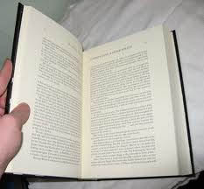
Amount of Print On Page

Slide 22
Print Size, Style and Format
Font and layout can make a difference
Font and layout can make a difference
Font and layout can make a difference
Font and layout can make a difference
Font and layout can make a difference
Font and layout can make a difference
Font and layout can make a difference
Font and layout can make a difference

Slide 23

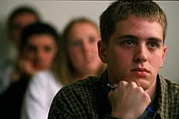
Sustained Attention &
Continued Performance
Notes:
Demands for sustained attention and continued performance can also trigger symptoms, as this puts greater stress on the brain.

Slide 24

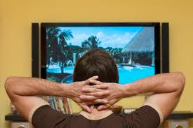
Activities as Stressors
Looking, Listening
Reading, Math
Writing, Copying
Scantron Answer Sheets
Computer, TV, Movies
Other Visually-Intensive Activities
Notes:
Certain activities, particularly visually intensive activities, can trigger symptoms of Irlen Syndrome.

Slide 25
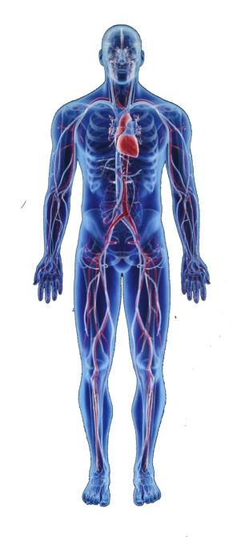
Impacts the Entire Body
Abnormal brain function
Headaches
Eye strain
Tense neck, back, shoulders
Shallow, labored, quickened, breathing
Nausea
Small and gross motor integration
SYSTEMIC IMPACT
Fatigue
Emotional, behavioral, psychological implications
ADD/HD
Depth perception & sensory integration
Sleeping difficulties
Visual fragmentation
SYSTEMIC IMPACT
Autonomic NS imbalance
Immune system suppressed
Endocrine system imbalance
Notes:
Because Irlen Syndrome affects the brain, it means that when the brain is under stress, it affects the entire body, often resulting in a variety of physical symptoms. These include headaches, eye strain, nausea and fatigue just to name a few. This stress, over a long period of time can also have a systemic effect, causing issues with the immune system or endocrine system, affecting sleep patterns, and even resulting in emotional, behavioral, or psychological implications.

Slide 26
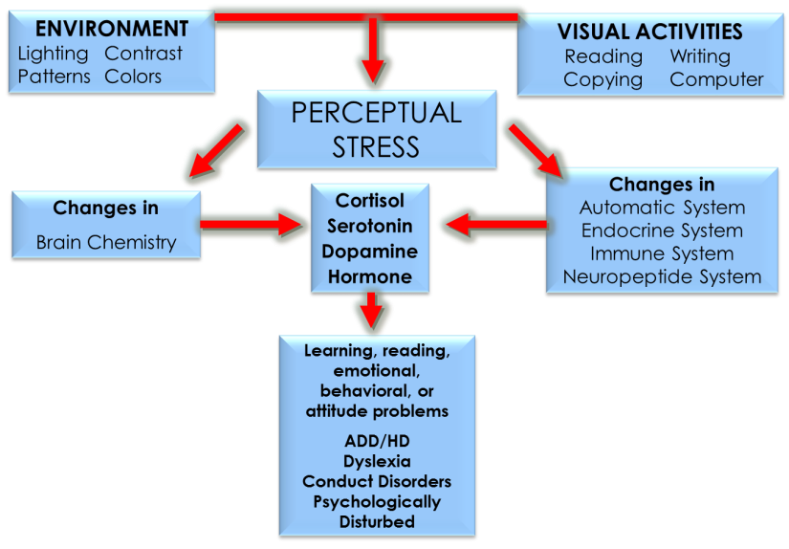
The Mind-Body-Learning Connection
Notes:
When either the environment or visually-intensive activities put stress on the brain, it results in changes in brain chemistry and changes to the nervous system. These changes impact cortisol, serotonin, dopamine, and hormone levels that in turn lead to the learning, reading, emotional, and behavioral issues often connected with Irlen Syndrome.

Slide 27
Irlen Syndrome is not…

Slide 28
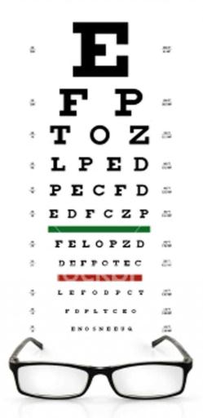


Not Identified By Current Tests
Educational
Medical
Ophthalmological
Notes:
Standard educational, psychological, medical and ophthalmological tests to not identify Irlen Syndrome.

Slide 29

Not A Method Of Instruction
READING INSTRUCTION
Notes:
The Irlen Method, Irlen Spectral Filters, and Irlen Colored Overlays are not a method of reading instruction, and they will not replace the need for reading instruction or remediation.

Slide 30
Who Has Irlen Syndrome?

Slide 31
Identifying the Population
46% Learning disabilities, reading problems
33% AD/HD, Dyslexia, behavior problems
14% General population, gifted, good readers
70% Head injury, concussion, or whip lash
30% Autism
Certain medical/visual/psychological conditions

Slide 32
Different Manifestations
Gifted
Longer to complete work
Strain, fatigue, headaches
Avoids reading for pleasure
Does poorly on timed tests
Unable to keep up
Emotional Problems
Anxiety
Behavior disorder
Average Student
“Could do better if tried harder”
AD/HD
Behavior problem
Grades do not reflect effort
Strain, fatigue, headaches
Learning Problems
Inefficient reading
Strain, fatigue, headaches
Good verbal skills
Notes:
Irlen Syndrome affects gifted and average students just as much as it affects individuals with learning problems. The disorder manifests itself differently within these different populations. For example, with the gifted student, you may not notice any issues with grades or academic performance, but this student will find themselves having to spend longer completing assignments than they should, and often pays a high price by suffering strain, fatigue or headaches.

Slide 33
Other Populations
Medical
  Headaches/Migraines
  Dizziness, Stomachaches
  AD/HD
  Autism/Asperger
  Light-Induced Epilepsy
  Depression, Anxiety, OCD
  TBI, Concussion, Whip Lash
  Stroke Victims
Diseases & Co-morbidity
  Auto Immune
  CFS
  Diabetes
  Multiple Sclerosis
  Cerebral Palsy
  Spina Bifida
  Parkinson’s Disease
  Fibromyalgia
  Viral Illnesses
  Hydrocephalus
  Myasthenia Gravis
  Lyme Disease
Visual & Co-morbidity
  Diseases/Impairments
  Astigmatism
  Low Vision
Notes:
Irlen Syndrome can be a factor in a variety of other populations as well, and should be considered as a factor contributing to an individual’s difficulties.

Slide 34
How Irlen Can Affect Perception

Slide 35

Environmental Distortions

Slide 36

Print Distortions
WATCH PRINT DISTORTIONS
Notes:
In presentation mode, if you have an internet connection, you can click on the link inside the TV to view an animated video of Irlen distortions.

Slide 37
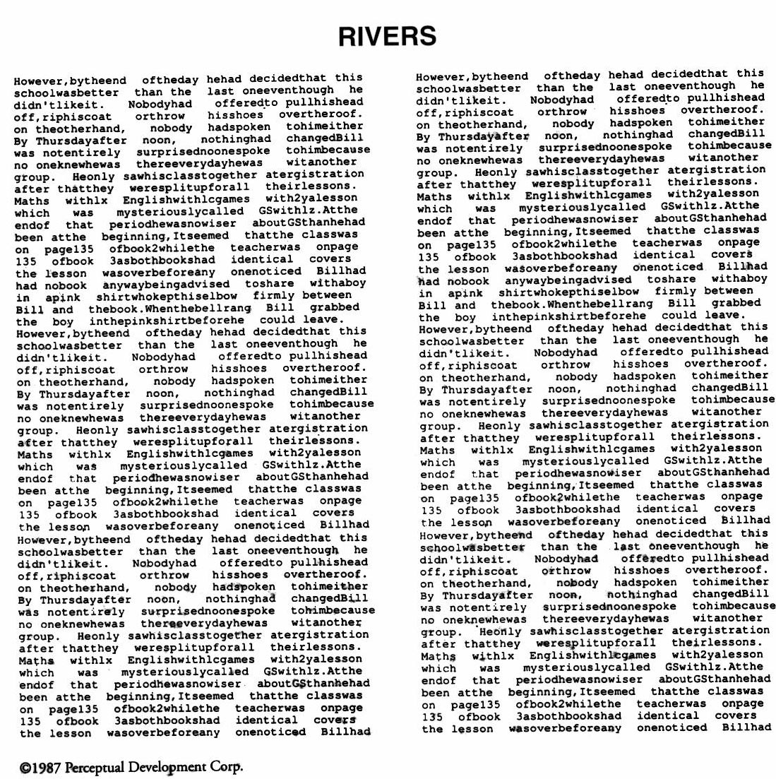
RIVERS
©2013 Perceptual Development Corporation

Slide 38
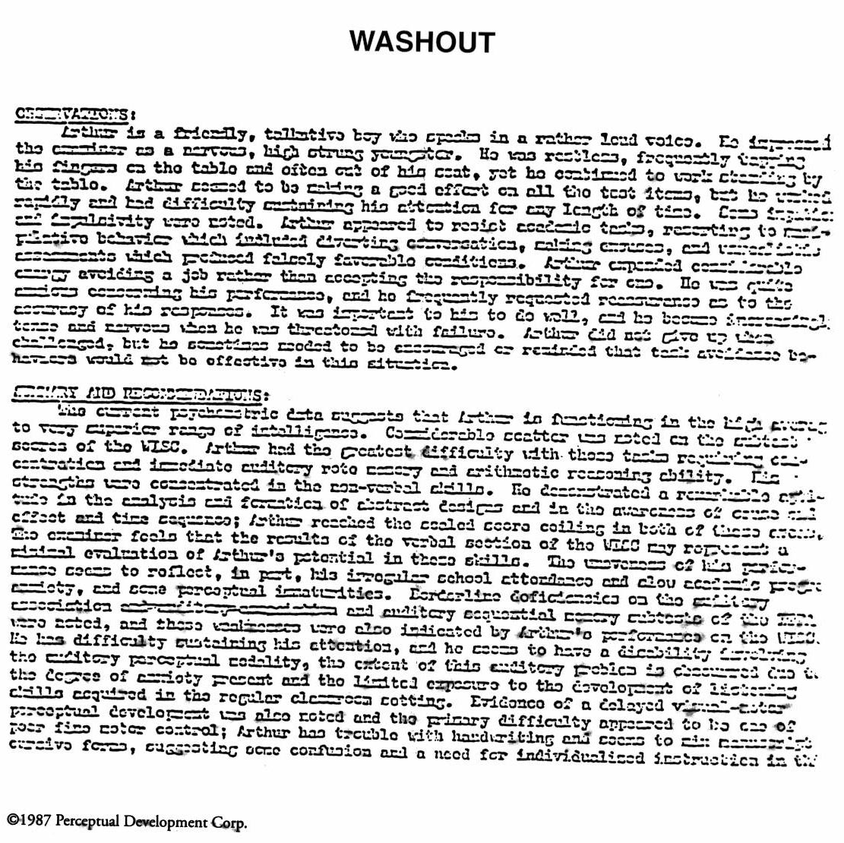
WASHOUT
©2013 Perceptual Development Corporation

Slide 39
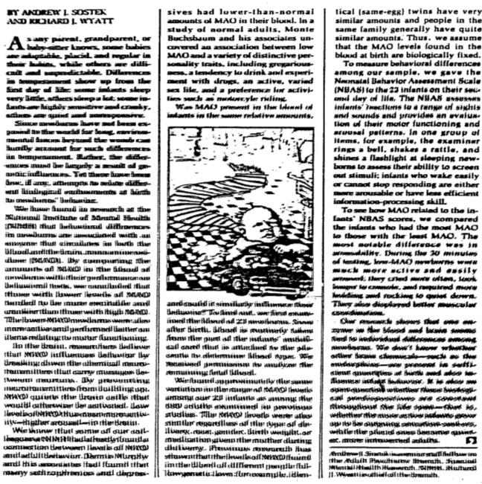
BLURRY
©2013 Perceptual Development Corporation

Slide 40

SHAKY
©2013 Perceptual Development Corporation

Slide 41
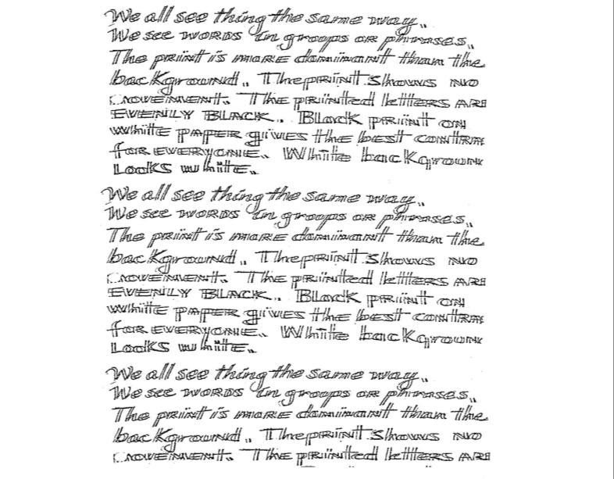
HALO
©2013 Perceptual Development Corporation

Slide 42

SWIRL
©2013 Perceptual Development Corporation

Slide 43

SEESAWS
©2013 Perceptual Development Corporation

Slide 44
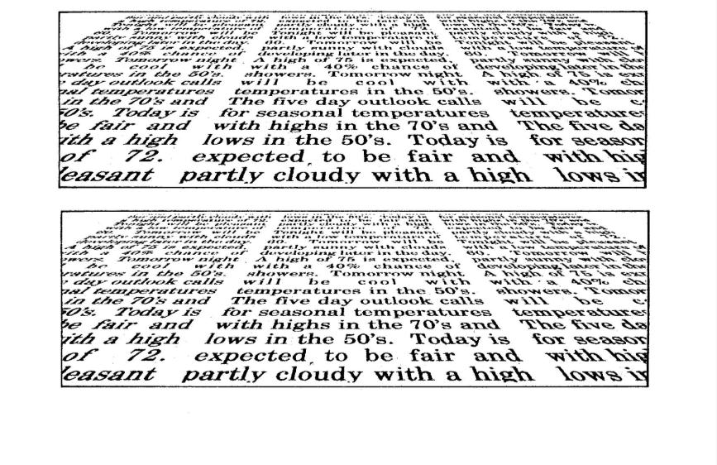
STAR WARS
©2013 Perceptual Development Corporation

Slide 45
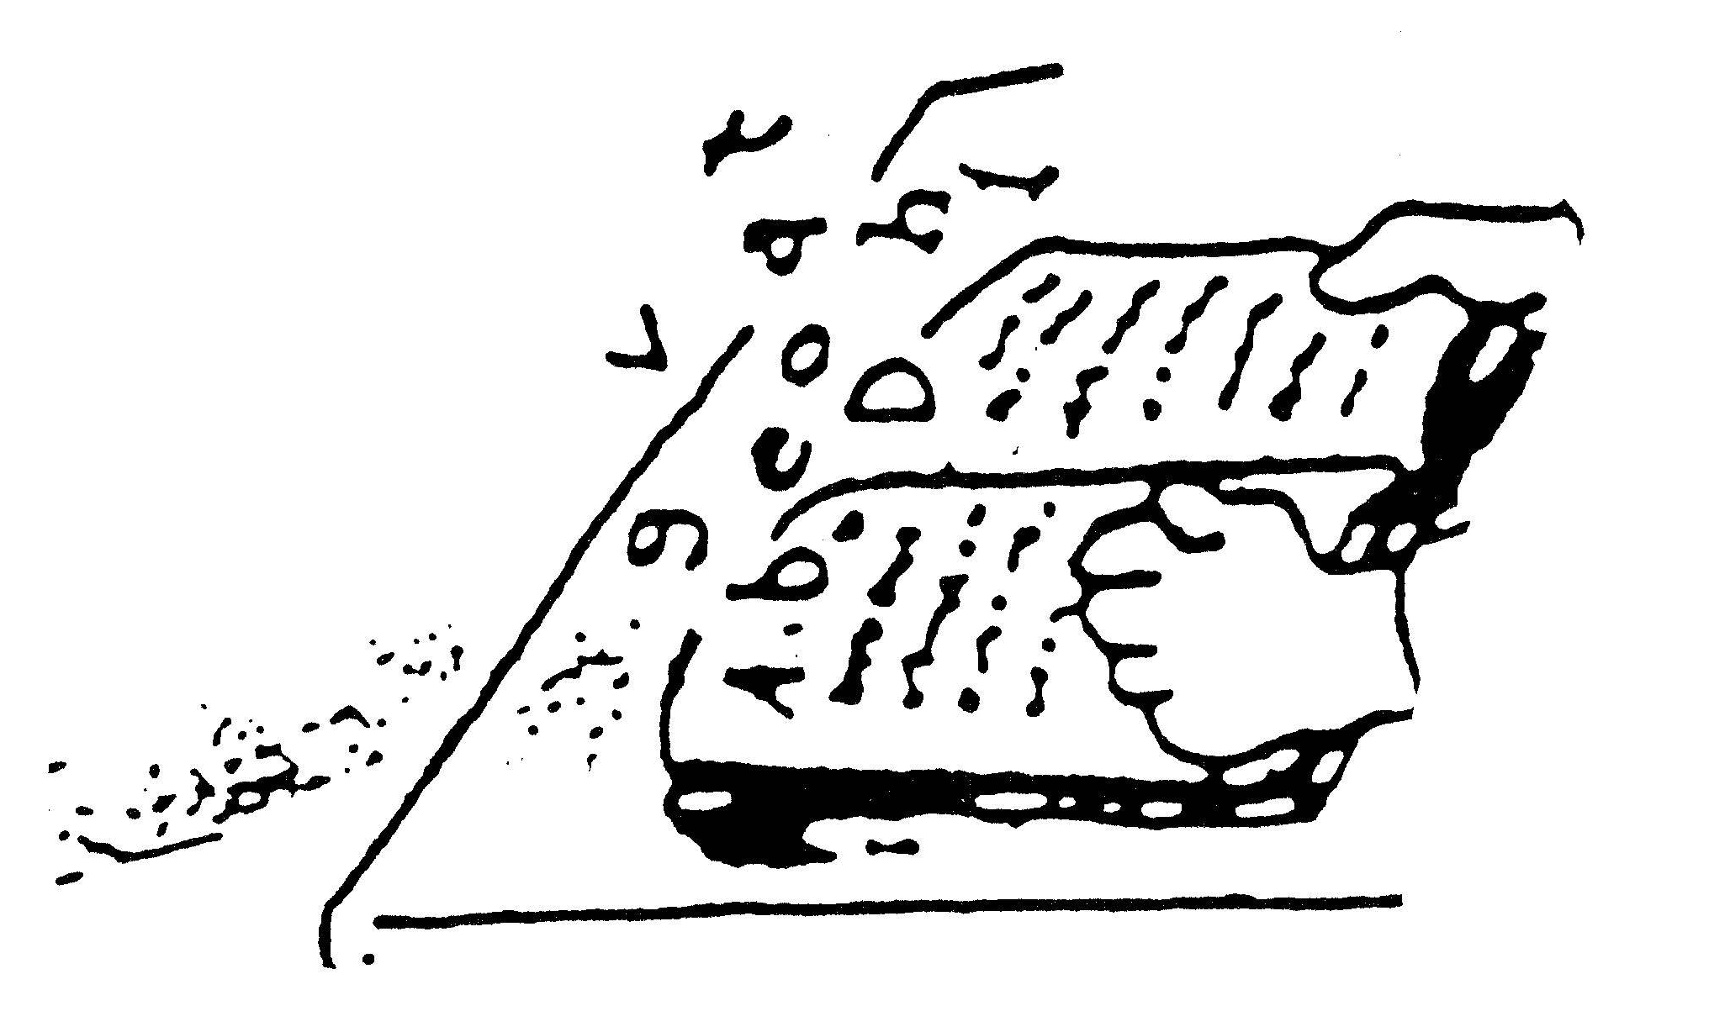
FLOATING
©2013 Perceptual Development Corporation

Slide 46

WAVY
©2013 Perceptual Development Corporation

Slide 47
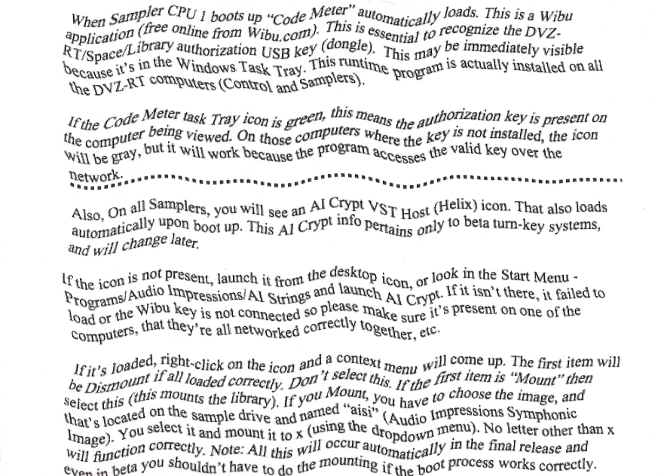
RIPPLE
©2013 Perceptual Development Corporation

Slide 48

THE SOLUTION
The Irlen Method

Slide 49

The Irlen Method
Screening & Overlays
❖
⬥
Testing & Irlen Spectral Filters
◆

Identify Students With Risk Factors
Additional Accommodations
& Modifications

Slide 50
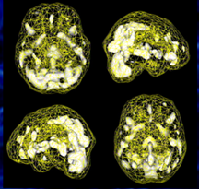
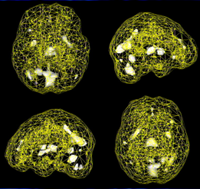
The Result: A Calmer Brain
Without Irlen Lenses
With Irlen Lenses
Courtesy of Daniel Amen, M.D.
Notes:
Daniel Amen used SPECT scans to show how wearing Irlen Spectral Filters calms an overactive brain. The image on the left side of the screen shows an individual with Irlen Syndrome who is not wearing his Irlen Spectral Filters. The white areas of the brain are considered “hot” or overactive parts of the brain, this includes the visual cortex. The image on the right side of the screen shows the same Irlen client when wearing his Irlen Spectral Filters. Brain function is normalized.

Slide 51
What Can You Do?
Notes:
The following slides are geared at teachers and other educators, but may be relevant to some other adult audiences as well. Please feel free to remove slides from the presentation that are not relevant to your audience.

Slide 52
Identify Irlen First
Identify & Correct Irlen
Avoid Misdiagnosis
Correct Intervention
Notes:
By identifying and treating Irlen Syndrome as a first course of action, you can avoid misdiagnoses and be able to provide the correct intervention(s) for any other issues the individual might have.

Slide 53
Identify Students With Risk Factors
Irlen Reading Strategies Questionnaire
Reading Difficulties
Discomfort
Skip words or lines
Lose place
Repeat lines
Misread words
Reading slow or choppy
Reading deteriorates
Rereads for comprehension
Eyes: hurt, ache, burn
Eyes: dry, sandy, scratchy, itchy, heavy
Sleepy
Headache, dizzy, nauseous
More difficult to read with bright or fluorescent lights
Notes:
If an individual has any of these issues, they may have Irlen Syndrome.

Slide 54
Identify Students With Risk Factors
Irlen Reading Strategies Questionnaire
Reading Difficulties
Discomfort
Skip words or lines
Lose place
Repeat lines
Misread words
Reading slow or choppy
Reading deteriorates
Rereads for comprehension
Eyes: hurt, ache, burn
Eyes: dry, sandy, scratchy, itchy, heavy
Sleepy
Headache, dizzy, nauseous
More difficult to read with bright or fluorescent lights

Slide 55
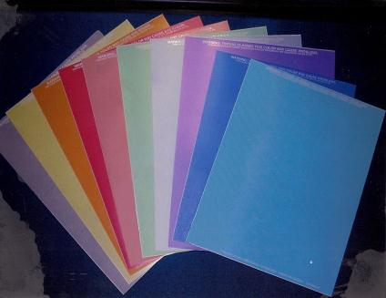
Become an Irlen Screener
Trained to:
Identify
Severity
Language
Educate
Counseling
Determine overlay color(s)

Slide 56
Overlay Tips
Self selection doesn’t work
Colors can be worse than white
Colors can be better than white
One color or colors that make the most difference

Slide 57
Classroom/At Home Modifications
Contrast
No bright or fluorescent colors
No stripes, plaids, or polka dots
No large or glittery jewelry or buttons
Lighting
Reduce lighting
Incandescent or indirect natural lighting
Gels over fluorescent http://www.rosco.com/us/filters/cinegel.asp
Visor or brimmed hat

Slide 58
Classroom Modifications
Whiteboards
Gray or brown
Colored marker/chalk (red and yellow are hard to see)
Write in columns
Paper
Recycled, off-white, non-glare
Different colors for different people
Computer/Overhead Projector
Use colored overlays

Slide 59

Reading Modifications
Irlen Spectral Filters
Colored overlays
Magnifying bar
Visor/brimmed hat
Bookstand
Markers
(above, below, to the side of the line)
Avoid fluorescent lighting
Dim lighting
Incandescent lighting

Slide 60

Testing Modifications
Tests duplicated on colored paper
Colored plastic overlays
Scantron answer sheets
Use a ruler
Natural lighting

Slide 61

For More Information
Email: irleninstitute@irlen.com
Reading by the Colors by Helen Irlen
The Irlen Revolution by Helen Irlen
You Tube Videos:
  Irlen Syndrome: A Teen’s Summary http://www.youtube.com/watch?v=9N5qbMFtKQ4
  ABC World News with Peter Jennings http://www.youtube.com/watch?v=91WOnEepH0A
www.irlen.com

