Slide 1
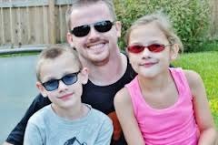
Color is in!
When You Have IRLEN SYNDROME

Slide 2
What is Irlen Syndrome?
Technically: The brain is unable to process certain wavelengths of light
In normal language: It’s like the brain is allergic to certain kinds of light

Slide 3
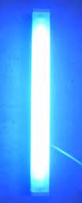
So What Happens?
Bright lights (like sunlight and fluorescent lights) can…
Hurt your eyes
Give you a headache
Give you a stomach ache
Make the words move when you’re trying to read
Make you feel jittery or anxious
Make the words on the page hard to look at
Make you blink or squint or rub your eyes
Make it hard to concentrate
The more you read the harder it is to focus and keep reading
And much more…

Slide 4
A few quick facts
Anyone can have Irlen Syndrome, not just people who have trouble reading
It runs in families (your mom or dad gave it to you!)
You can also get it after having a concussion or head injury
You can get it from a condition like Lyme Disease
Different people have different symptoms (I might get headaches or migraines when I read, and you might see words move on the page or cannot pay attention in class)
It’s not a problem with your eyes – it’s a brain thing!
Also called Visual Sensory Stress, Visual Dyslexia, Scotopic Senstivity Syndrome and Irlen –Meares Syndrome

Slide 5
What do people see?
WATCH PRINT DISTORTIONS
* If you have Internet available, click on the link to watch an animated video

Slide 6
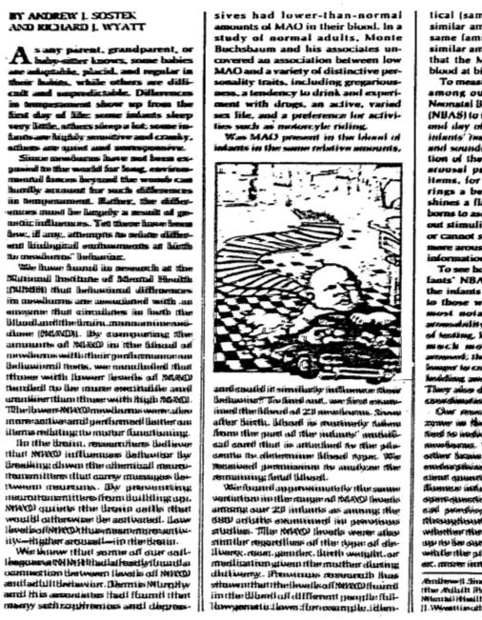
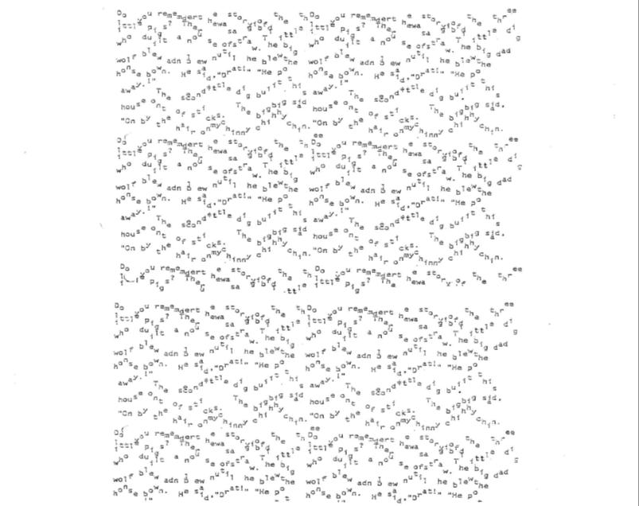
What do people see?
A few examples…
Blurry
Rivers
Seesaw

Slide 7
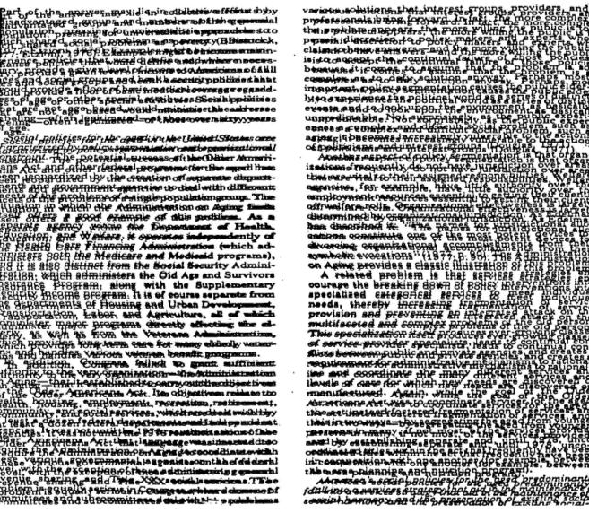
What do people see?
A few more examples…
Star Wars
Swirl
Washout
And there are lots more!

Slide 8
What else happens?
Some people see distortions in their environment

Slide 9
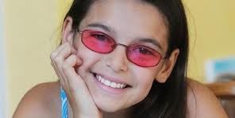
What can you do about it?
Wear Irlen Spectral Filters or Colored Overlays to protect your brain from the color it doesn’t like
Feel more relaxed when you read, do math, write , work at the computer, drive, or concentrate

Slide 10
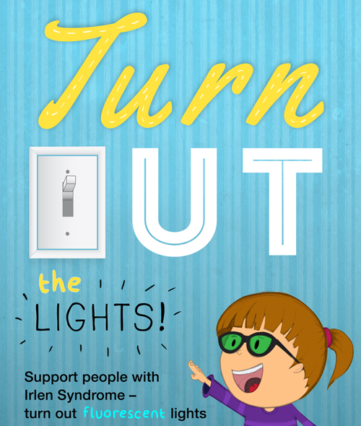
What else can you do?
Use colored paper to do your work
Wear a hat to protect from light above
Dim or turn out fluorescent and other bright lights (use old-fashioned incandescent light bulbs instead)

Slide 11
How do I know if I have it?
Reading Difficulties
Discomfort
Skip words or lines
Lose place
Repeat lines
Misread words
Reading slow or choppy
Reading gets harder the longer you read
Trouble understanding what you read
Eyes: hurt, ache, burn
Eyes: dry, sandy, scratchy, itchy, heavy
Sleepy
Headache, dizzy, nauseous
More difficult to read with bright or fluorescent lights

Slide 12
Is this text easier to see or read when the background is this color?
Try different colors

Slide 13
Is this text easier to see or read when the background is this color?
Try different colors

Slide 14
Is this text easier to see or read when the background is this color?
Try different colors

Slide 15
Is this text easier to see or read when the background is this color?
Try different colors

Slide 16
Is this text easier to see or read when the background is this color?
Try different colors

Slide 17
Is this text easier to see or read when the background is this color?
Try different colors

Slide 18
Is this text easier to see or read when the background is this color?
Try different colors

Slide 19
Is this text easier to see or read when the background is this color?
Try different colors

Slide 20
Is this text easier to see or read when the background is this color?
Try different colors

Slide 21
Where can I get more info?
www.irlen.com
www.irlenvlcmd.com
www.aotss.com
See Facebook
For more information or to take a self-test

Slide 22
Spread the word
October 18- 24, 2015
Join Us To Raise Awareness:
Web: http://irlen.com/irlen-syndrome-awareness-week-2014/
Facebook: Irlen Awareness Week
Twitter: @seeirlen #irlenawareness
www.irlenvlcmd.com Abilities OT & Irlen Learning Services

